Slide 1
Training Information Management System (TMIS)
Presented by
Syed sana ul haq fazli

Slide 2
About Me
Education:
MS-IT from University of NorthWest (USA)
BCS from University of Windsor (Canada)
Experience:
Currently Working as a Data Manager (Consultant) in UN-WFP
Worked in IFES as a Web Developer/Programmer for 3 years
Worked in UN-WFP as a Senior Programme Associate (Database) for 4 years
Worked in TEKenable (Irish SW House) as a Software Developer for 2 years
Skills:
Drupal 7/8
.Net / SQL Server
PHP/MYSQL

Slide 3
Main Features of TMIS
Web enabled database
Accessible to all DAI staff through password protected log-in
Every log-in has its own authority and privileges
Can accommodate data of all DAI employees
Module for entering data of all polling staff and related training records
Module for managing a contacts lists (internal and external offices)
Module for managing training courses information and its Schedule.
Useful for multiple sections of the DAI
Module for managing the information of the related organizations and their contacts

Slide 4
Technical features of TMIS
Advanced Security
User registration system
Export to CSV/HTML/Excel/Word/XML/PDF/Email
File uploading to database or folder
Master/Detail-Add/Edit/View
Custom template

Slide 5
Reports: (Overall/district/region/province/gender)
Employees who have been trained
Every individual training with participants and other details
Participant Detail Training Wise
Total Training attended by Employees
Training Attended by Organizations
Grade wise lists of employees
Contact detail report
Organization detail report

Slide 6
TMIS Flow Chart
Organization
Information
Training
Information
Contact
Information
Classifications
Categories
Trainings
Training
Arrangements
Training
Information

Slide 7
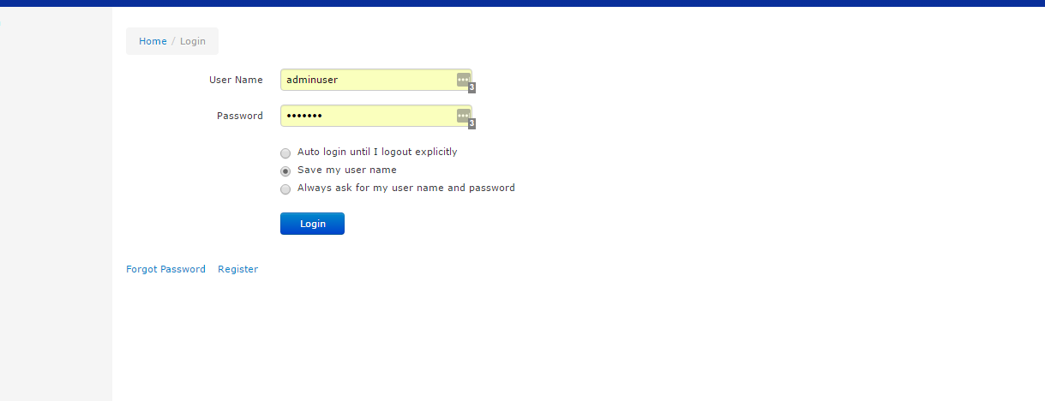
Demonstration of TMIS

Slide 8
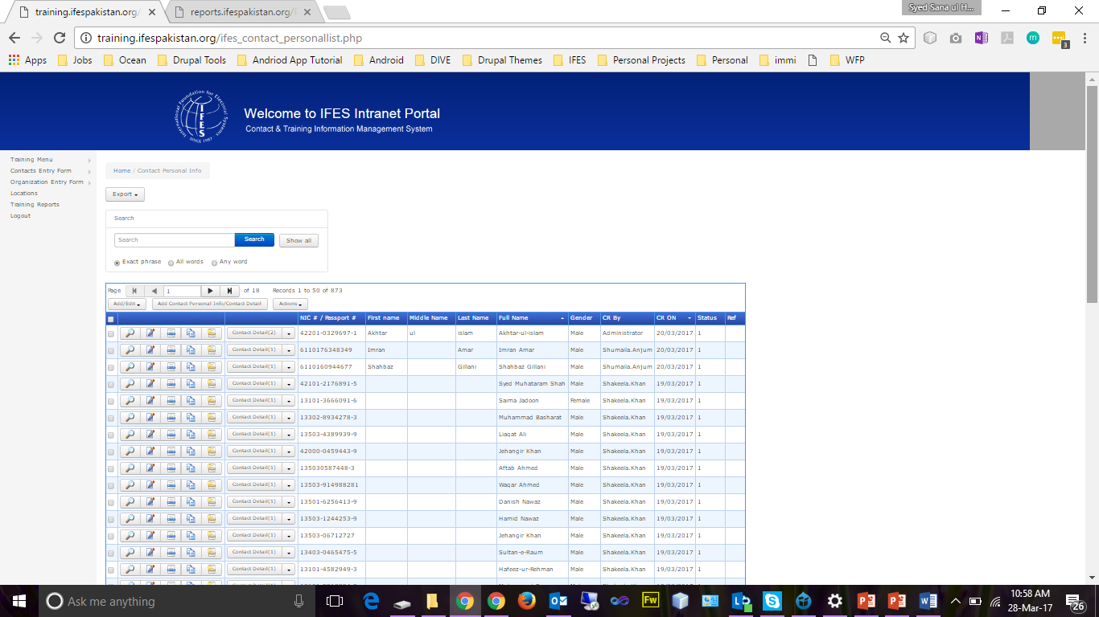
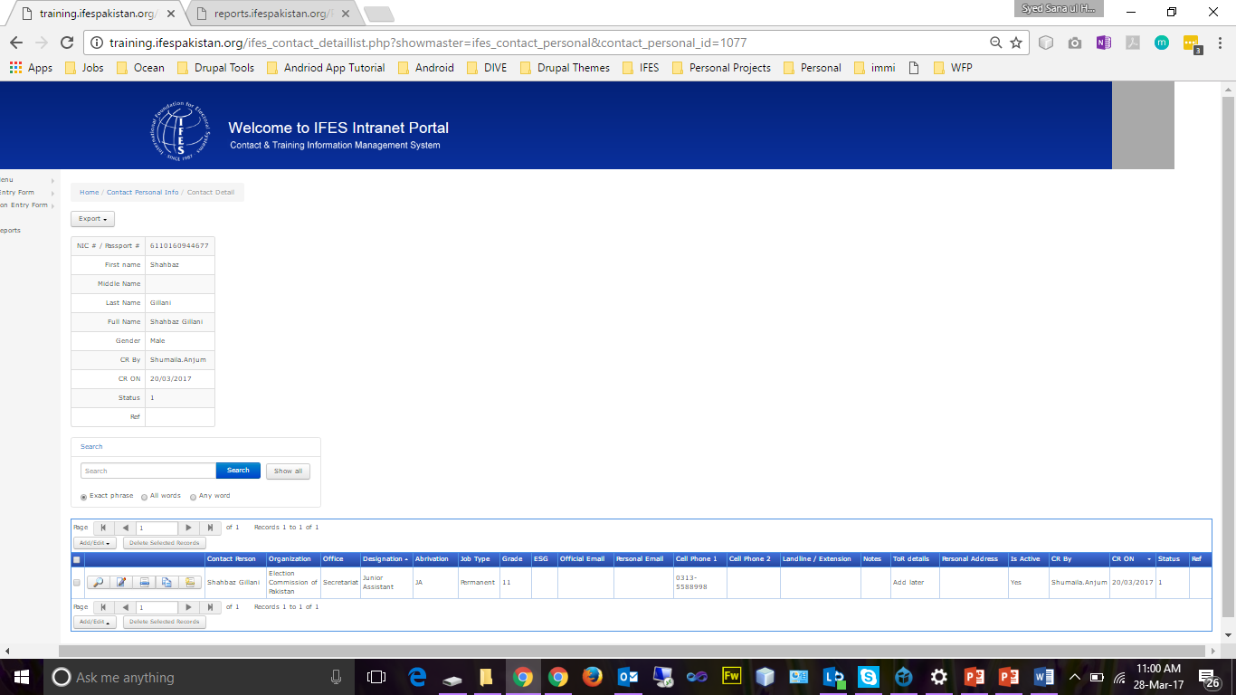
Contact MIS
Contact Main Information
Contact Detail Information

Slide 9
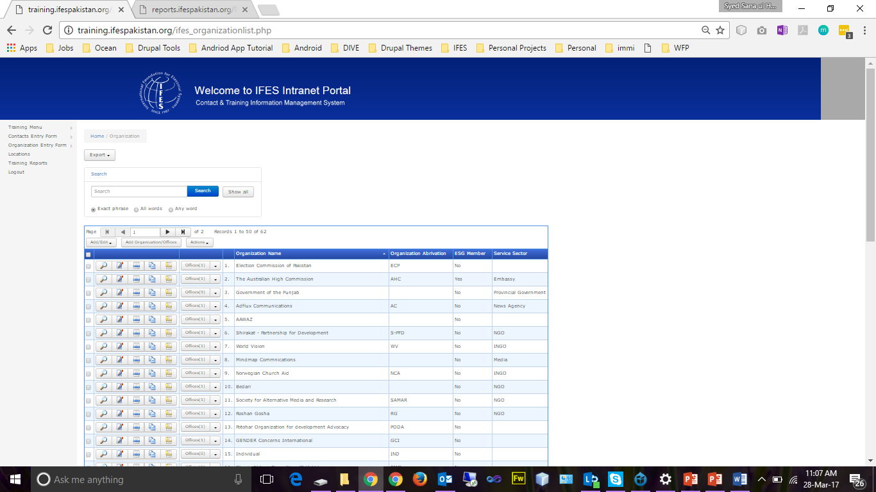
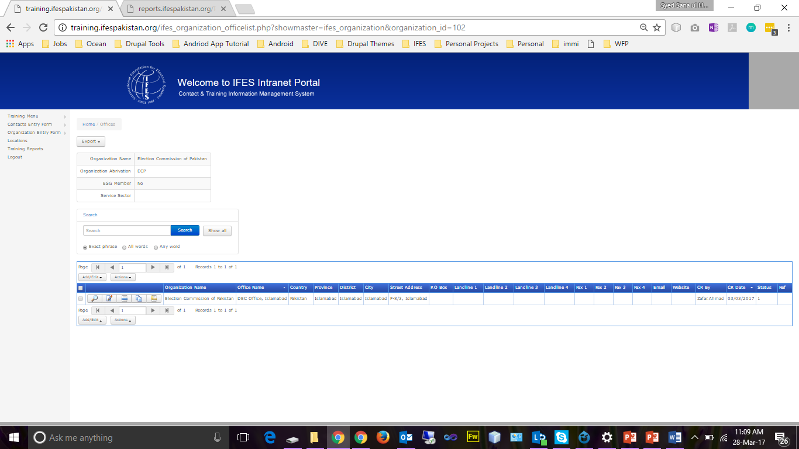
Organization MIS
Organization Main Information
Organization offices Information

Slide 10
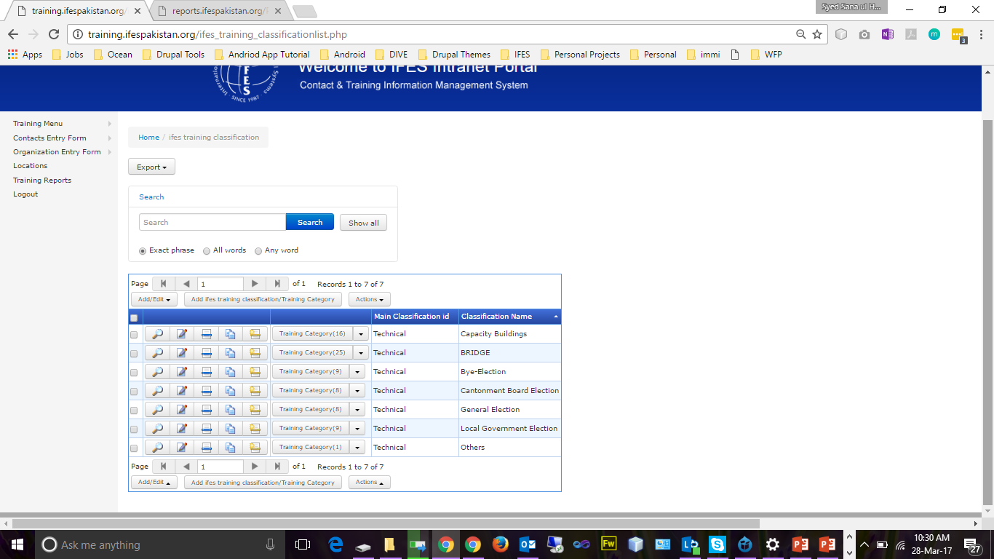
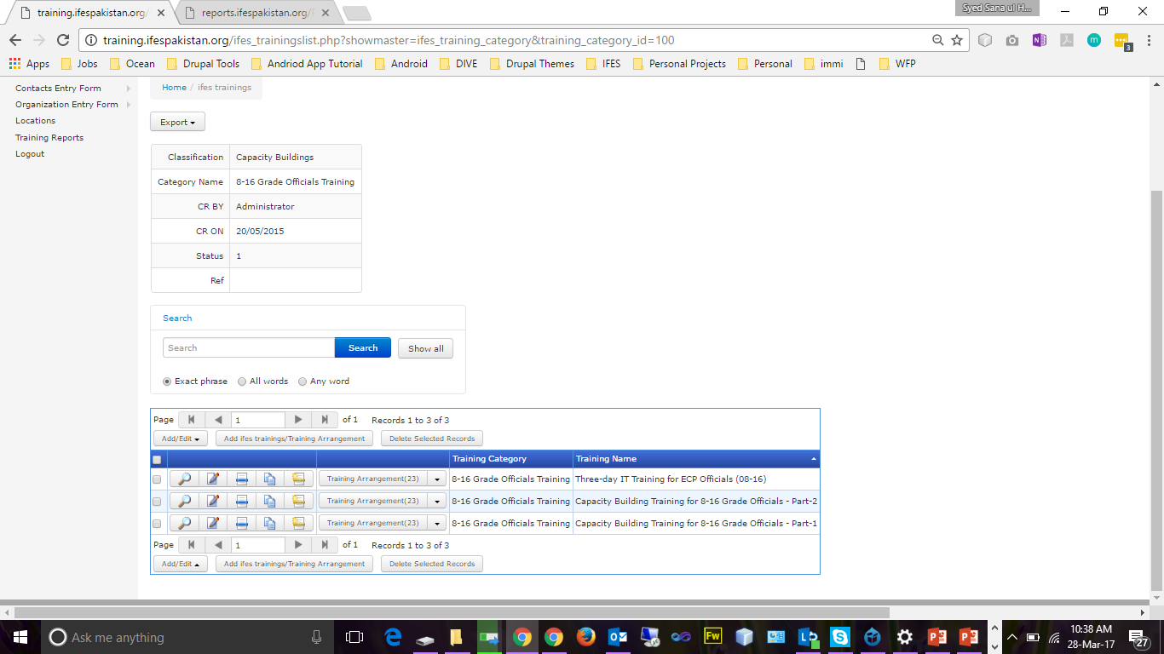
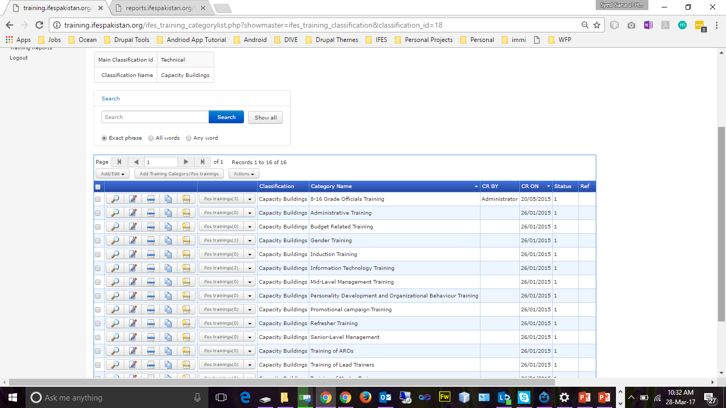
Training Entry Forms
Classifications
Trainings
Categories

Slide 11
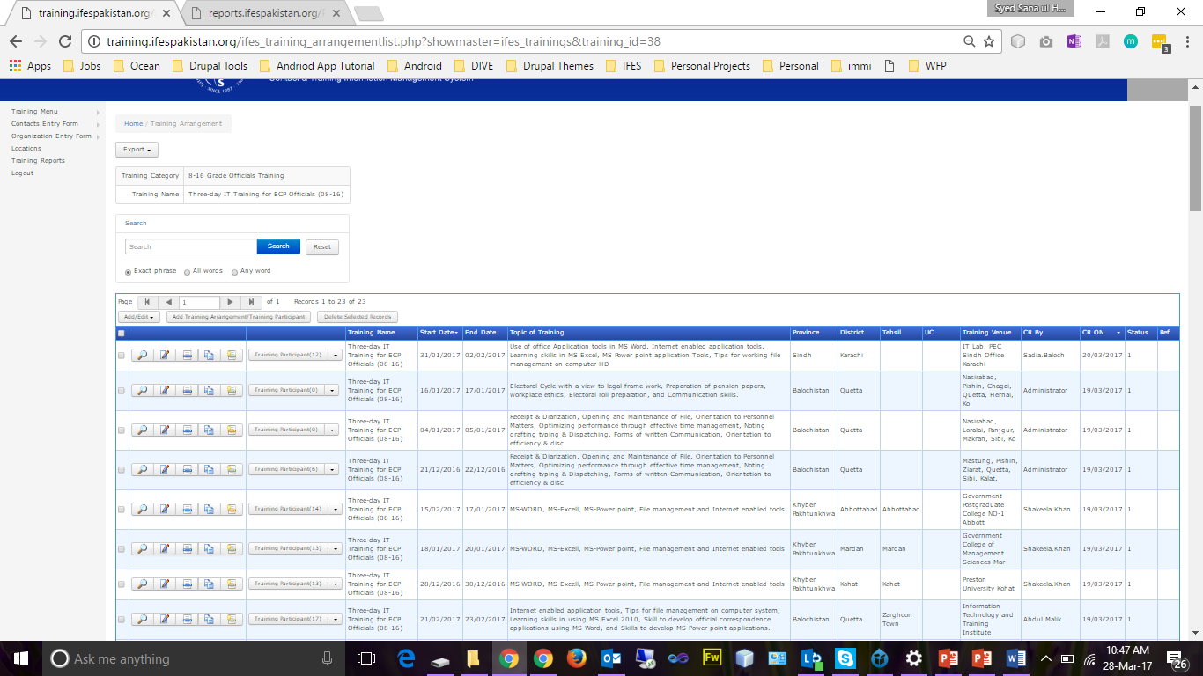
Training Entry Forms (Continue..)
Trainings
Training Arrangements

Slide 12
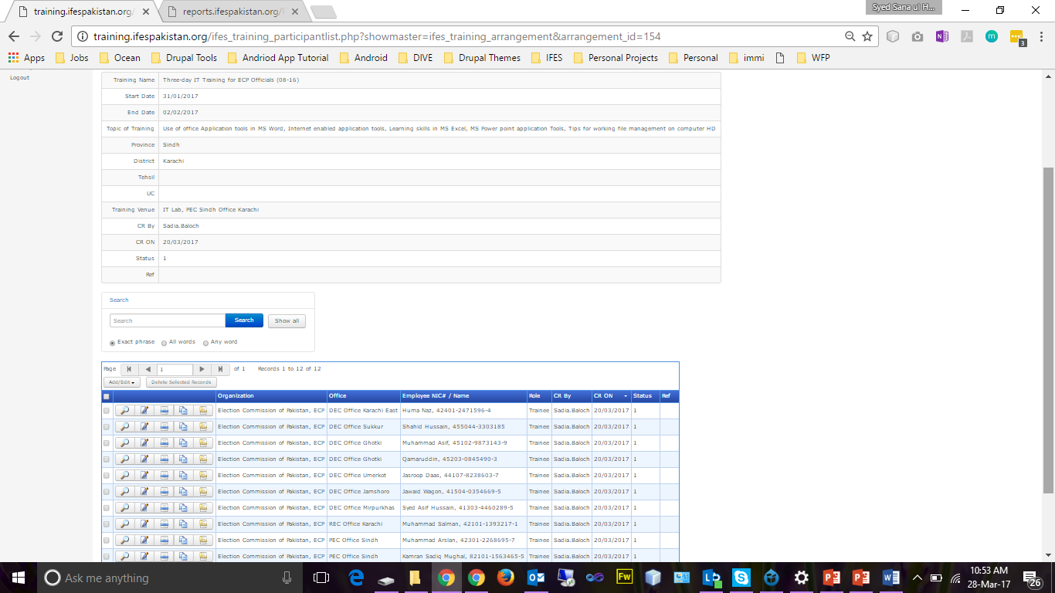
Training Entry Forms (Continue..)
Training Arrangements
Training Participants

Slide 13
Reports
Participant Detail Training Wise
Total Training attended by Participants
Training Attended by Organizations
Contact Reports
Organization Reports

Slide 14
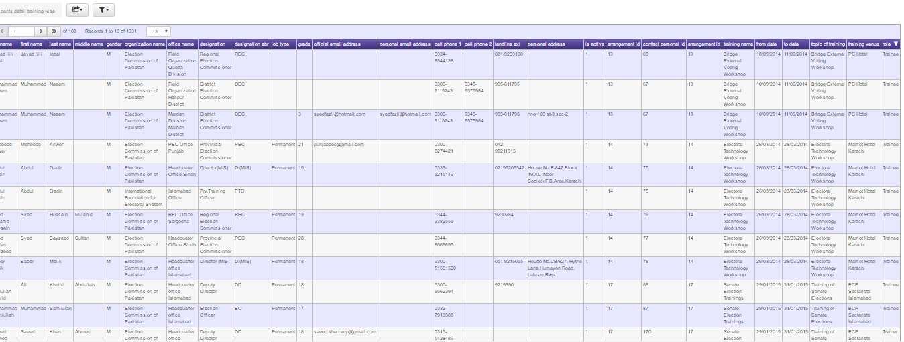
Participant attended trainings
Filter by role (Trainers / Trainees)

Slide 15
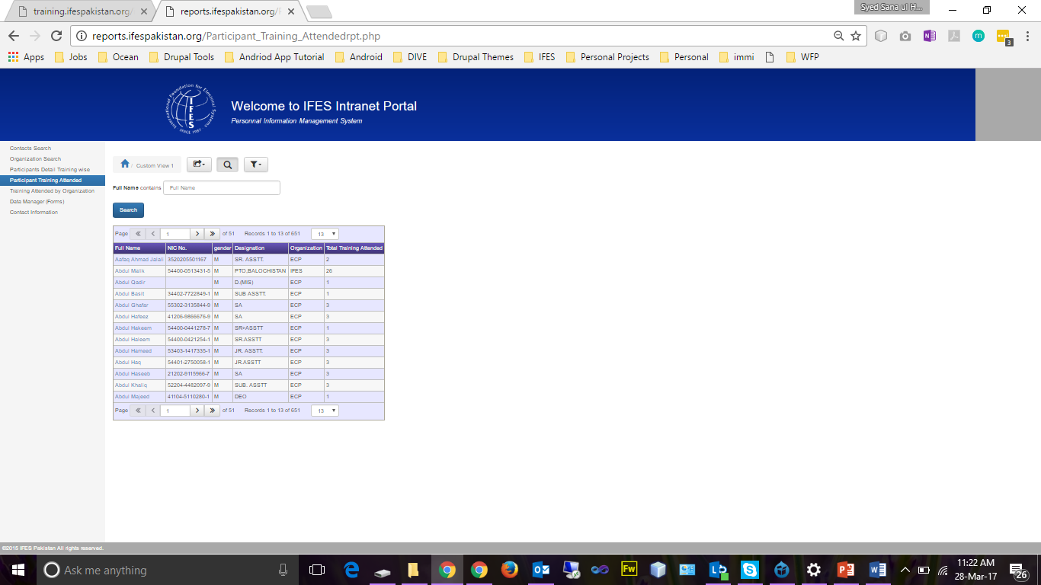
Total Trainings attended by participants
Filter by Participant Name

Slide 16
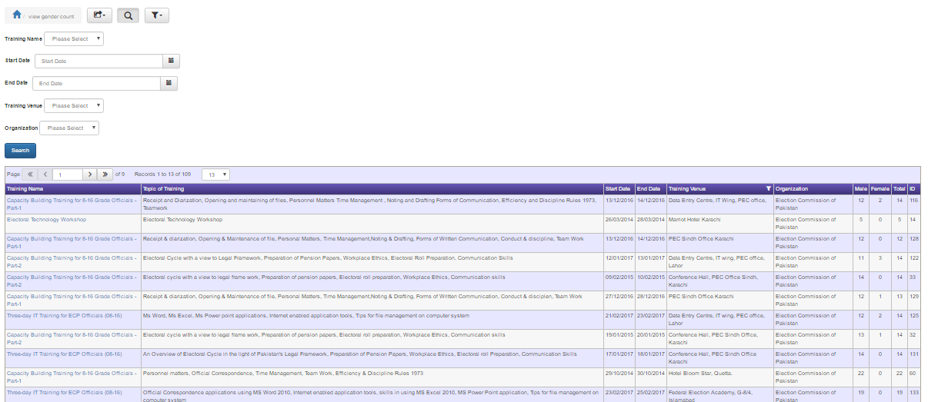
Trainings attended by organizations

Slide 17
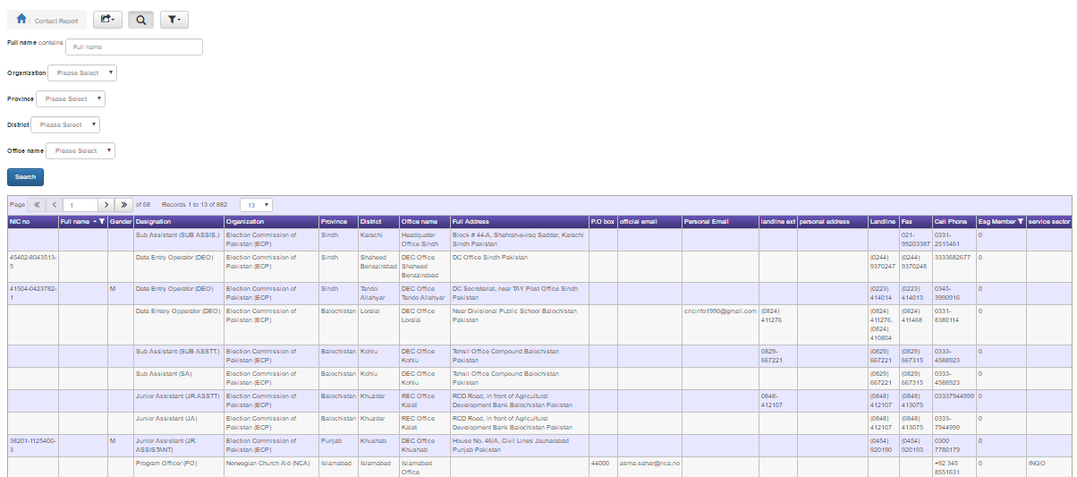
Contact Full Report

Slide 18
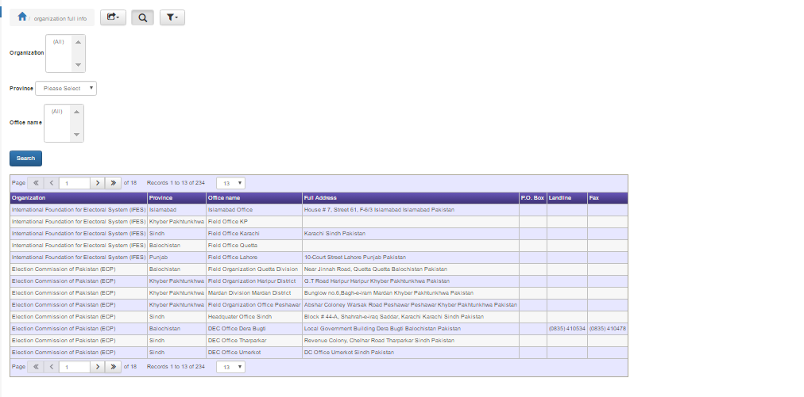
Organization Full Report

Slide 19
Technical Requirements
Apache HTTP Server 2.*
PHP 5.*
MySQL 5.*
PHPMaker 10.*
PHP Report Maker 8.*
Linux Hosting (1 GB Minimum)
Domain Name

Slide 20
Additional Features
Module for listing of 'Job descriptions and Position Descriptions’
Module for online training courses and results management
Useful for multiple sections of the DAI
Module for submission of Training needs of the employees
Module for linking ACR with data of each individual employee

Slide 21
Any Questions???

